Slide 1
Computer Network (CS3002)
Spring Semester (2021-2022)
Dr. Judhistir Mahapatro
Department of Computer Science and Engineering
National Institute of Technology Rourkela

Slide 2
Elementary Data Link Protocols
Utopian Simplex Protocol
Simplex Stop-and-Wait Protocol
  Error-Free Channel
Simplex Stop-and-Wait Protocol
  Noisy Channel

Slide 3
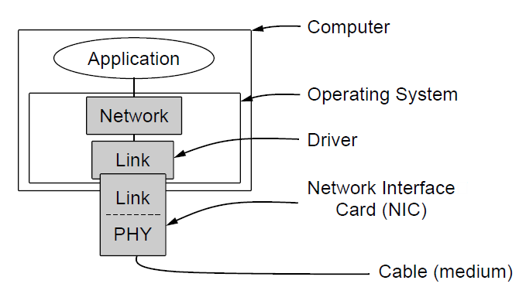
Elementary Data Link Protocols
Assumption that the physical, data link, and network layers are independent processes that communicate by passing messages back and forth.

Slide 4
Elementary Data Link Protocols
Another key assumption is that machine A wants to send a long stream of data to machine B, using a reliable, connection-oriented service.
B also wants to send data to A simultaneously.
A always has enough data (or produced) to send
  When A’s data link layer asks for data to network layer, it is always able to comply
Machine don’t crash.
  Protocol deals with the communication errors

Slide 5
Elementary Data Link Protocols
The data link layer is waiting for something to happen by the procedure call
wait_for_event(&event)
Procedure only returns when something has happened (e.g., a frame has arrived)
Receiver finds transmission error, then it is informed to data link layer (event=chsum_err)
If inbound frame is undamaged, it is also informed to the data link layer (event=frame_arrival)

Slide 6
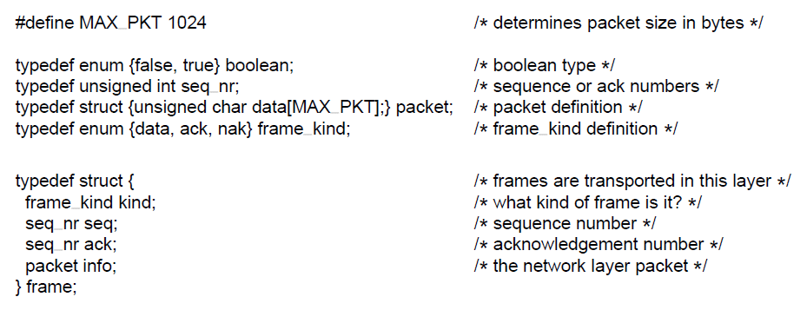
Elementary Data Link Protocols
Some definitions needed in the protocols to follow. These definitions are located in the file protocol.h.

Slide 7
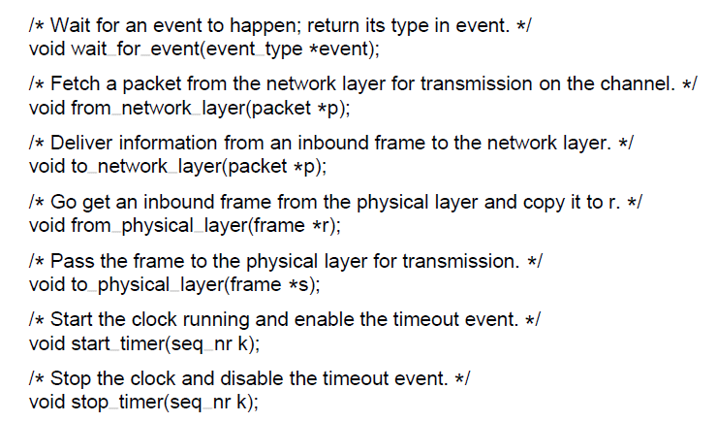
Elementary Data Link Protocols

Slide 8
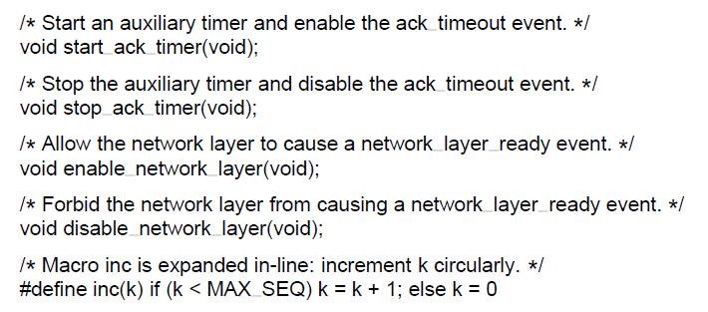
Elementary Data Link Protocols

Slide 9
Utopian Simplex Protocol
Data are transmitted in one direction only.
Both transmitting and receiving network layers are always ready.
Processing time can be ignored.
Infinite buffer space is available.
Communication channel between the data link layer never damages or loses frames.
  “Utopia”-simply unrealistic

Slide 10
Utopian Simplex Protocol
A Sender and A Receiver --Two distinct procedures
No sequence number and acknowledgment number
  MAX_SEQ is not needed
Only event is frame_arrival (i.e., arrival of an undamaged frame).
There are no error and flow control restrictions.
Frame
A
B
Sender
Receiver

Slide 11
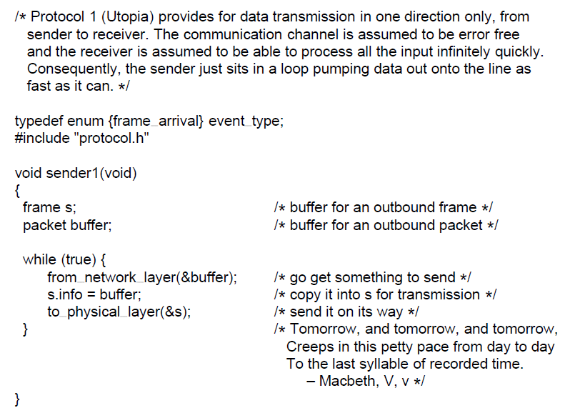
Utopian Simplex Protocol

Slide 12
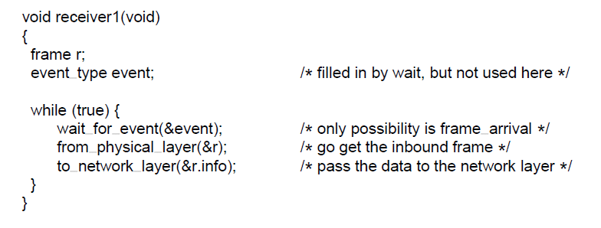
Utopian Simplex Protocol
A utopian simplex protocol.

Slide 13
Simplex Stop-and-Wait Protocol for an Error-Free
Channel
Tackle the problem of preventing the sender from flooding the receiver with frames faster than the receiver able to process them.
Frame
A
B
Sender
Dummy Frame
Receiver
A half-duplex physical channel would suffice here.

Slide 14
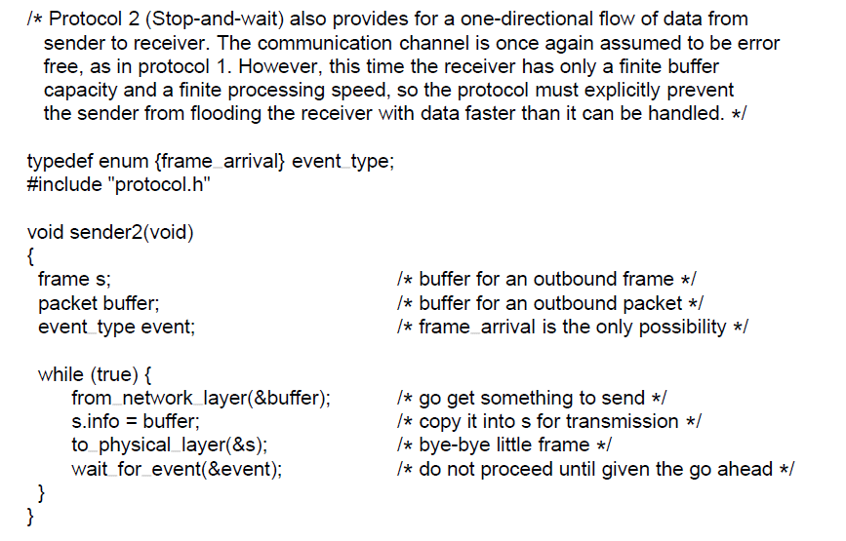
Simplex Stop-and-Wait Protocol for an Error-Free
Channel

Slide 15
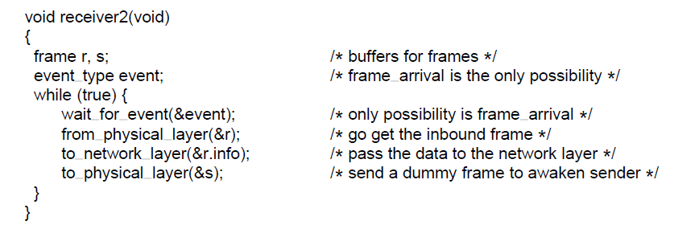
Simplex Stop-and-Wait Protocol for an Error-Free
Channel

Slide 16
Simplex Stop-and-Wait Protocol for a Noisy Channel
Consider the normal situation of a communication channel that makes errors.
  Frames may be either damaged or lost completely.
  Receiver hardware detects it after computing Checksum

Slide 17
Simplex Stop-and-Wait Protocol for a Noisy Channel
Adding a Timer
  Receiver would send an ACK only when it receives the data correctly
  In damaged frame case, sender sends the frame again if it times out after not receiving ACK
  Still we might go wrong.
  Unlikely, can cause a duplicate packet to be delivered to a network layer. (Scenario in next slide)

Slide 18
Simplex Stop-and-Wait Protocol for a Noisy Channel
Packet1
Packet1
Frame1
A
B
Sender
Ack
Receiver
Packet1
Packet1
Frame1
A
B
Sender
Ack
Receiver
Sends Packet1 again

Slide 19
Simplex Stop-and-Wait Protocol for a Noisy Channel
Some way for the receiver to be able to distinguish a frame that it is seeing for the first time from a retransmission.
  Sender put a sequence number in the header of each frame it sends
  A 1-bit sequence number (0 or 1) is sufficient.

Slide 20
Simplex Stop-and-Wait Protocol for a Noisy Channel
At each instance of time, the receiver expects a particular sequence number next.
  Frame comes with correct sequence number, accepts it
    Acknowledges to the sender.
    Sender advances the sequence number
  Frame with wrong sequence number is considered as duplicate and rejected.
    Last valid ACK is sent

Slide 21
Simplex Stop-and-Wait Protocol for a Noisy Channel
Protocols in which sender waits for a positive acknowledgment before advancing to the next data item are often called ARQ (Automatic Repeat Request) or PAT (Positive Acknowledgment with Retransmission)

Slide 22
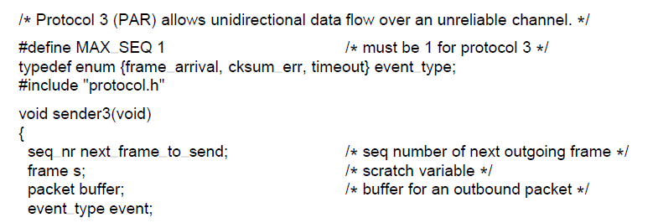
Simplex Stop-and-Wait Protocol for a Noisy Channel

Slide 23
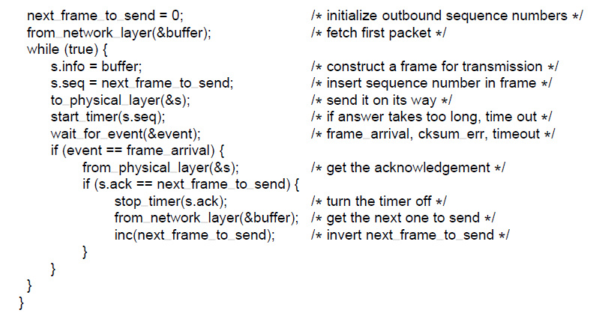
Simplex Stop-and-Wait Protocol for a Noisy Channel

Slide 24
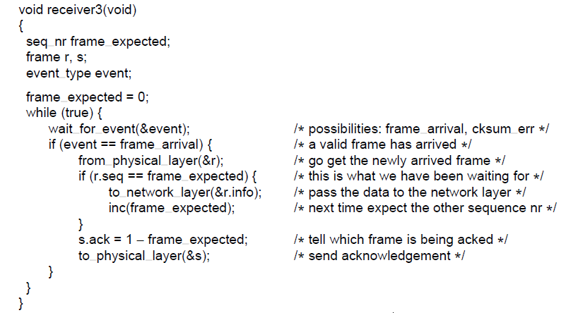
A positive acknowledgement with retransmission protocol.

Slide 25
Sliding Window Protocols
One way is to achieve full-duplex data transmission
  Run two instances of one of the previous protocols
  Using a separate link
  Each link is divided into forward channel (for data) and reverse channel (for acknowledgement)
  Capacity of reverse channel is entirely wasted.

Slide 26
Sliding Window Protocols
A better idea is to use same link for data transmission in both directions.
  Data frames from A to B are intermixed with Acknowledgement frames from A to B.
  Temporarily delaying outgoing acknowledgements so that they can be hooked onto the next outgoing data frame is known as Piggybacking
    Better use of available channel bandwidth

Slide 27
Sliding Window Protocols
  How long data link layer wait for a packet to come in from network layer?
    Fixed number of milliseconds, which is shorter duration than time out period
    If a packet does not come in within this fixed time, then a separate ACK is sent (not piggybacked)

Slide 28
Sliding Window Protocols
  Use sequence numbers ranging from 0 to some maximum number
    For n-bit field, so maximum is 2^{n} - 1

Slide 29
Sliding Window Protocols
  Sender maintains a set of sequence numbers corresponding to frames it is permitted to send
    Fall within the Sending window
  Receiver maintains a set of sequence numbers corresponding to frames it is permitted to receive
    Fall within the Receiving window
  Windows need not have the same lower or upper limits, or even have the same size
      They can grow or shrink over the course of time

Slide 30
Sliding Window Protocols
  Sender’s window represents
    Frames that have been sent or can be sent but are as not yet acknowledged.

Slide 31
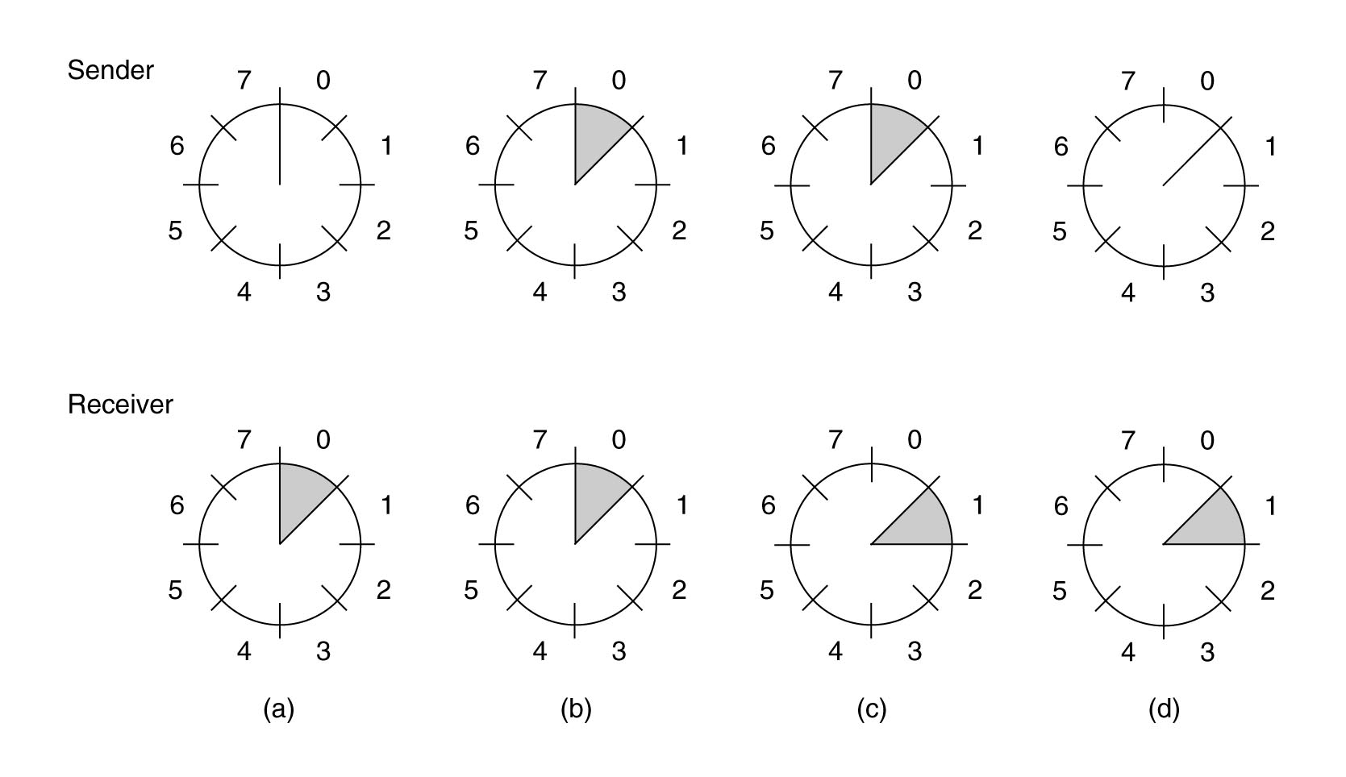
Sliding Window Protocols
A sliding window of size 1, with a 3-bit sequence number (a) Initially. (b) After the first frame is sent.
(c) After the first frame has been received. (d) After the first acknowledgement has been received.

Slide 32
One-Bit Sliding Window Protocol
  Examine a sliding window protocol with a window size of 1.
  Protocol uses a stop-and-wait
    Sender transmits a frame and waits for its acknowledgement before sending the next one

Slide 33
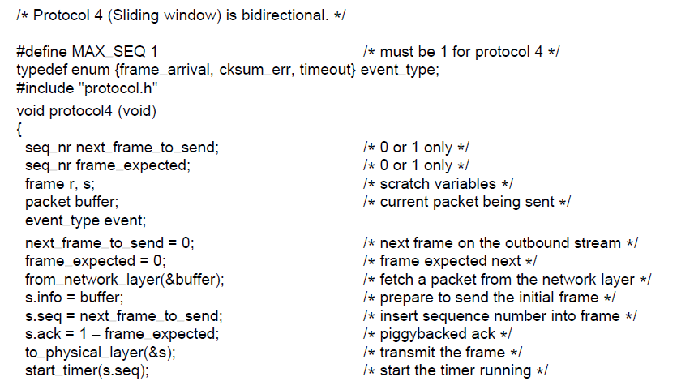
One-Bit Sliding Window Protocol

Slide 34
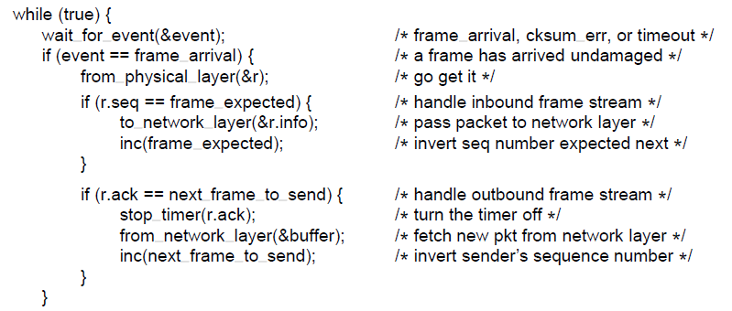
One-Bit Sliding Window Protocol

Slide 35
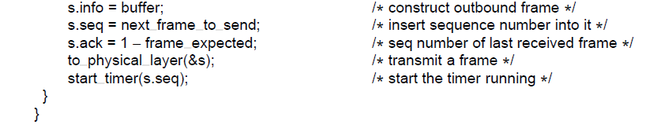
One-Bit Sliding Window Protocol

Slide 36
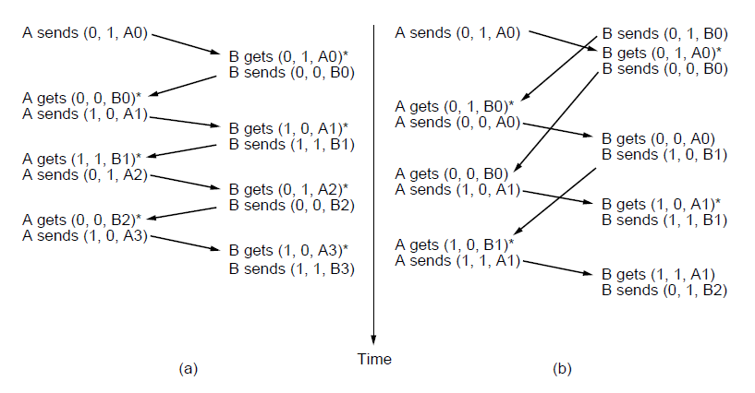
One-Bit Sliding Window Protocol
Two scenarios for protocol 4. (a) Normal case. (b) Abnormal
case. The notation is (seq, ack, packet number). An asterisk indicates where a network layer accepts a packet

Slide 37
A protocol using Go-Back-N
A tacit assumption that
transmission time for a frame to arrive
+
transmission time for ack to come back
is negligible
Clearly false, sometimes

Slide 38
A protocol using Go-Back-N
Long round-trip time can have important implications for the efficiency of the bandwidth utilization.

Slide 39
A protocol using Go-Back-N
Example: A 50-kbps satellite channel with a 500 msec round-trip propagation delay. Let us send 1000-bit frames via satellite.
  At t=0, sender send the first frame
  At t=20 msec the frame has been completely sent
  Not until t=270 msec has the frame fully arrived at the receiver.
  Not until t=520 msec has the acknowledgement fully arrived back at the sender.
  Sender was blocked for 500/520 or 96% of the time.
  Only 4% of available bandwidth was used.

Slide 40
A protocol using Go-Back-N
For finding appropriate w value, that is, how many number of frames can fit inside the channel
F3
F2
F1
F4
F3
F2
A
B
A
B
Receiver
Sender
Ack1
Sender
Receiver
Fig1
Fig2
F5
F4
F3
A
B
Sender
Ack1
Ack2
Receiver
Fig3

Slide 41
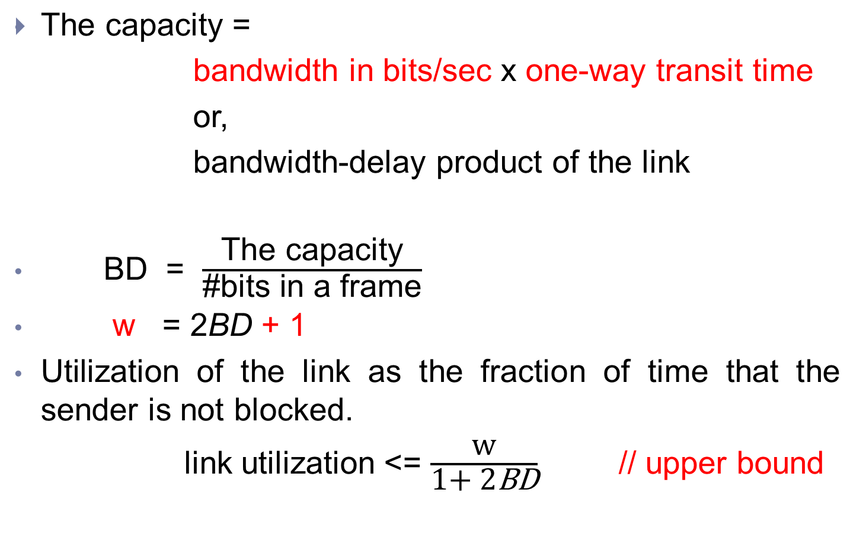
A protocol using Go-Back-N

Slide 42
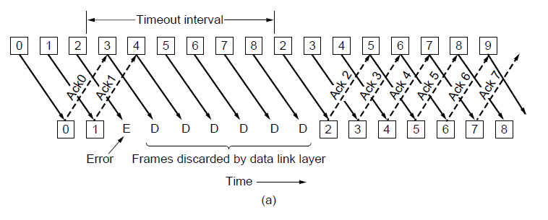
Protocol Using Go-Back-N
Pipelining and error recovery. Effect of an error when
(a) receiver’s window size is 1

Slide 43
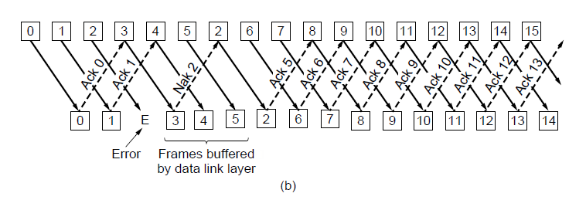
Protocol Using Go-Back-N
Pipelining and error recovery. Effect of an error when
(b) receiver’s window size is large.

Slide 44
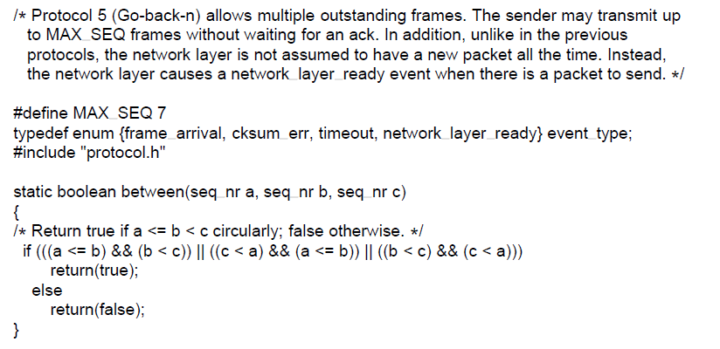
Protocol Using Go-Back-N

Slide 45
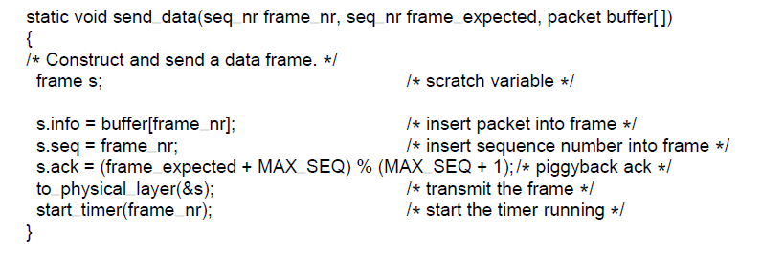
Protocol Using Go-Back-N

Slide 46
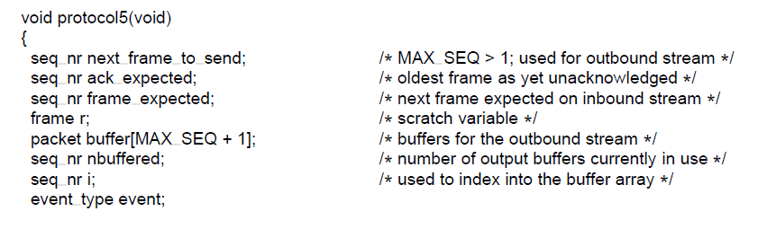
Protocol Using Go-Back-N

Slide 47
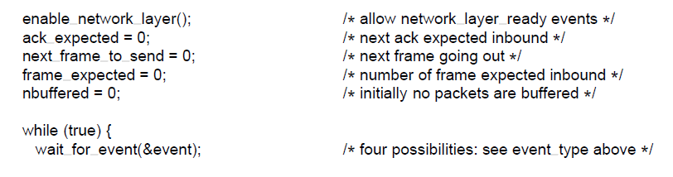
Protocol Using Go-Back-N

Slide 48
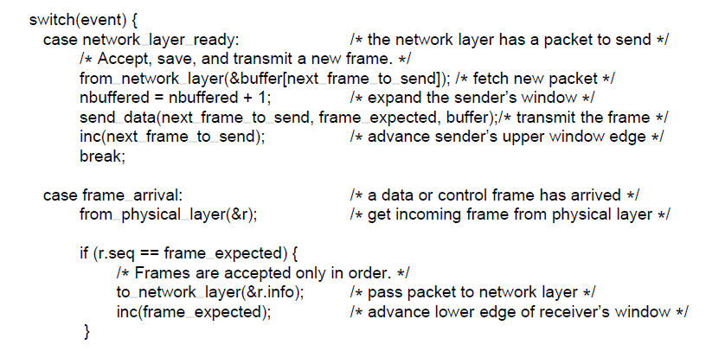
Protocol Using Go-Back-N
A sliding window protocol using go-back-n.

Slide 49
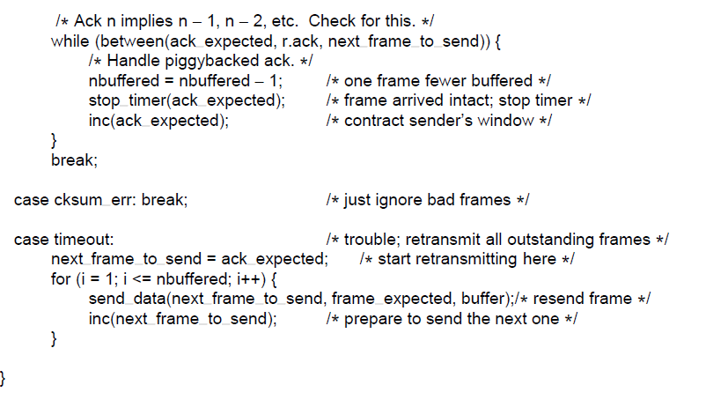
Protocol Using Go-Back-N
A sliding window protocol using go-back-n.

Slide 50
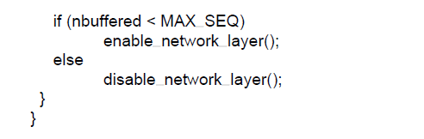
Protocol Using Go-Back-N

Slide 51
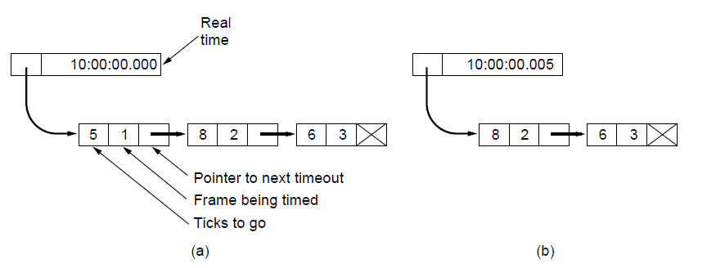
Protocol Using Go-Back-N
Simulation of multiple timers in software. (a) The queued
timeouts (b) The situation after the first timeout has expired.

Slide 52
Protocol Using Selective Repeat
It is to allow the receiver to accept and buffer the frames following a damaged or lost one.
Both sender and receiver maintain a window of outstanding and acceptable sequence numbers.
Sender’s window size starts out at 0 and grows to some predefined maximum.
Receiver’s window, is always fixed in size and equal to predetermined maximum.
Receiver has a buffer reserved for each sequence number within its fixed window.

Slide 53
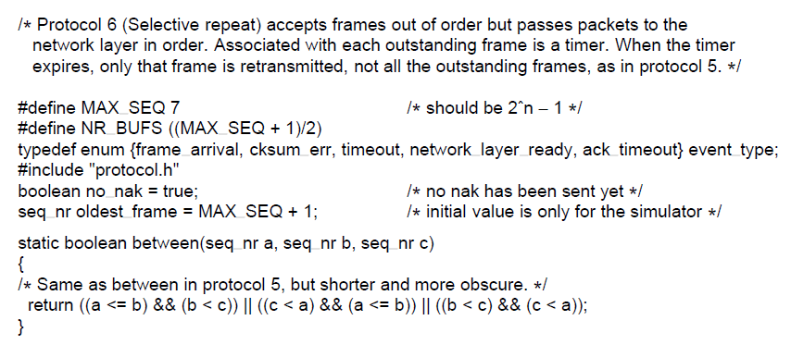
Protocol Using Selective Repeat

Slide 54
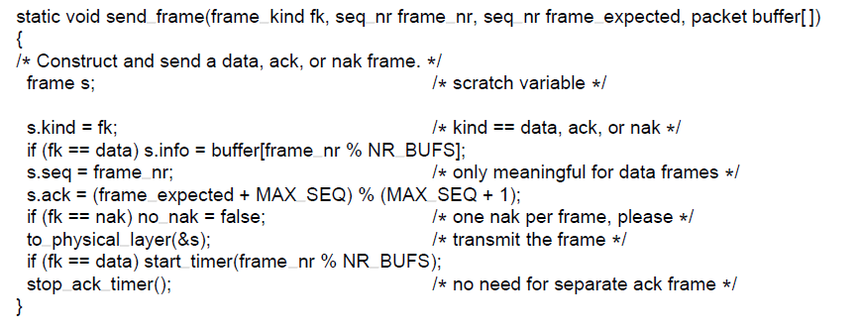
Protocol Using Selective Repeat

Slide 55
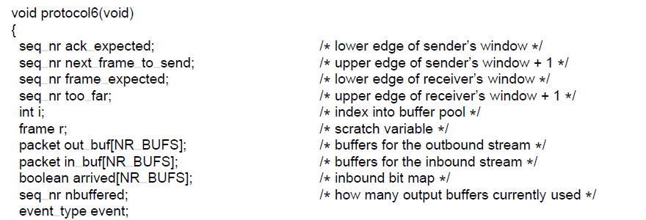
Protocol Using Selective Repeat

Slide 56
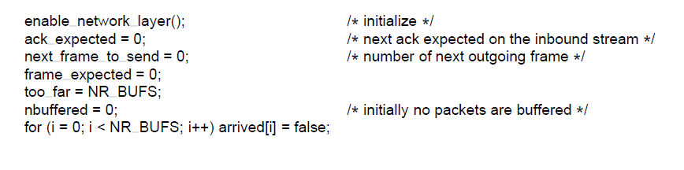
Protocol Using Selective Repeat

Slide 57
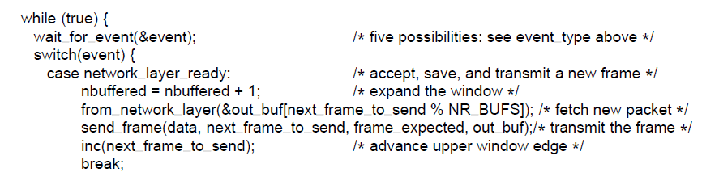
Protocol Using Selective Repeat

Slide 58
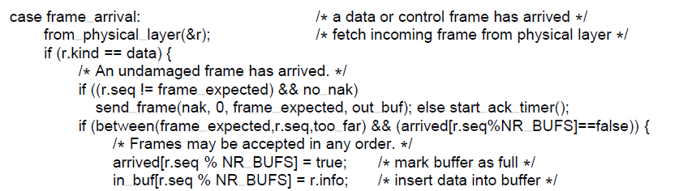
Protocol Using Selective Repeat

Slide 59
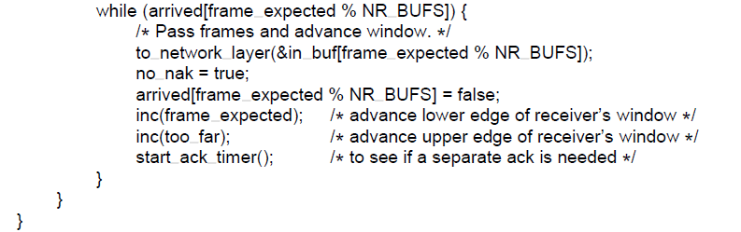
Protocol Using Selective Repeat

Slide 60
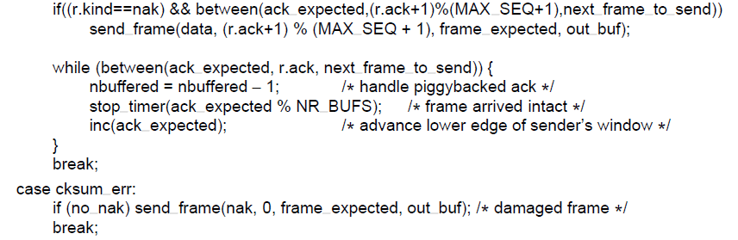
Protocol Using Selective Repeat

Slide 61
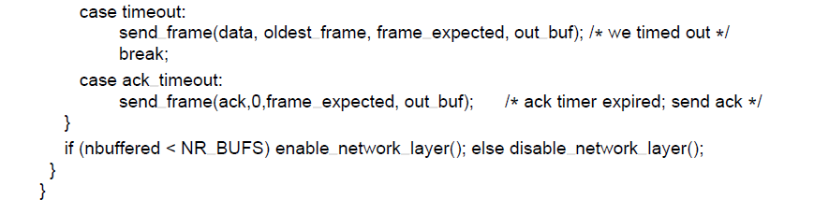
Protocol Using Selective Repeat

Slide 62
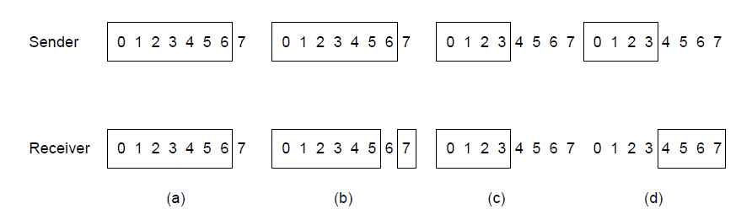
Protocol Using Selective Repeat
(a) Initial situation with a window of size 7
(b) After 7 frames sent and received but not acknowledged.
(c) Initial situation with a window size of 4.
(d) After 4 frames sent and received but not acknowledged.

Slide 63
Protocol Using Selective Repeat
Window size will be (MAX_SEQ + 1)/2

Slide 64
Which one is best among two Protocols
Tradeoffs between efficient use of Bandwidth and data link layer buffer space.

Slide 65
Reference
Computer Networks, Fifth Edition by Andrew Tanenbaum and David Wetherall, Pearson Education-Prentice Hall, 2011

